Slide 1



Denver Dev Day
May 31th, 2019
Thanks to our sponsors!

Slide 2
AWS CDK
The Only Unit Testable IaC for AWS
(and why that matters)
@mattbonig

Slide 3
Who am I
Professional Developer 10+ years
Enterprise/SMB application architect
Node/Angular (recovering .NET)
AWS Certified Solutions Architect

Slide 4
Quick Audience Check
Never have written IaC before
Has only done a getting started
Does it on a side project
Does it every day
Used AWS-specific IaC tools (CF/Terraform)

Slide 5
What is IaC
Infrastructure as Code (IaC) is the management of infrastructure (networks, virtual machines, load balancers, and connection topology) in a descriptive model – Azure Docs

Slide 6





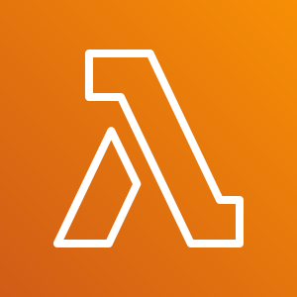





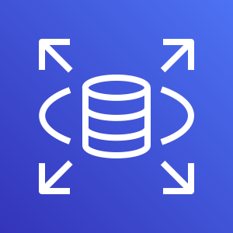
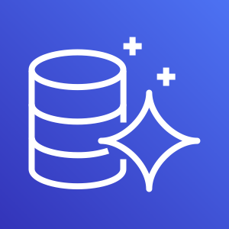
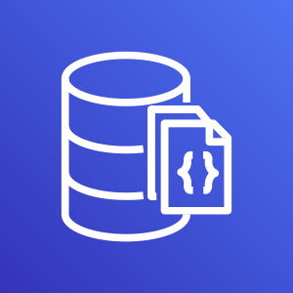

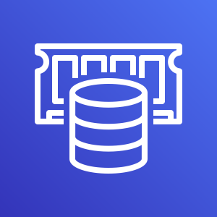


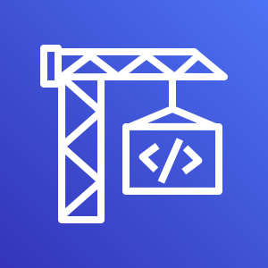
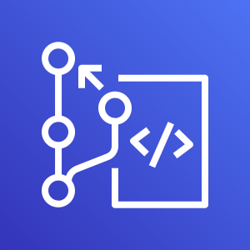
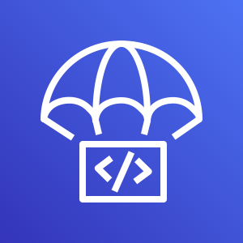
Why we use IaC
Notes:
Service Oriented Architecture
Infrastructure & Supporting Services
DB
Search
Email
VMs
Lambda
CICD
Application
Infrastructure

Slide 7
SDLC of an Application
Promote
Development
Test
Review
Deploy
Notes:
Development
Review
Deploy
Verify

Slide 8
SDLC of IaC
Promote
Development
Test
Review
Deploy
Notes:
Development
Review
Deploy
Verify

Slide 9



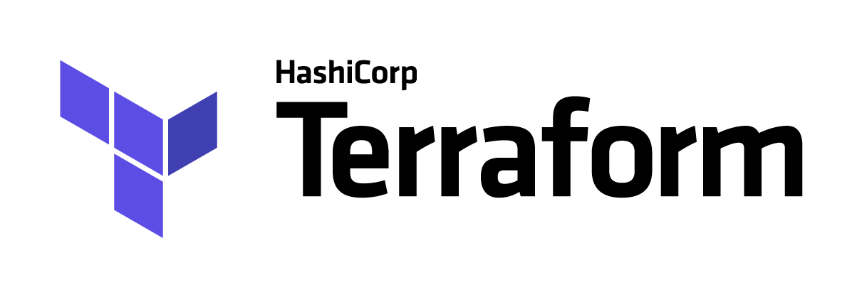

AWS & IaC Options
AWS CDK
AWS CloudFormation
AWS Amplify

Slide 10
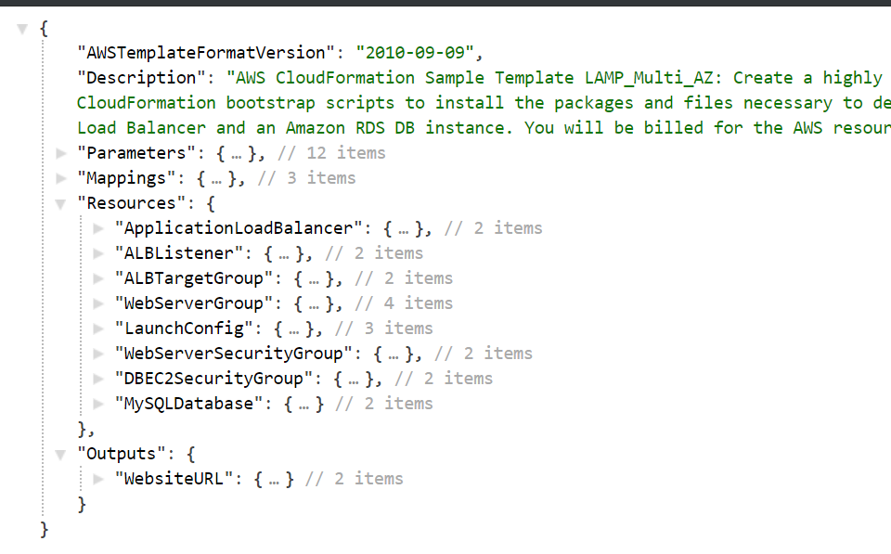
CloudFormation

Slide 11
Glossary
Orders of magnitude in SDLC:
1 min
5 min
15 min*
30 min
1 hr
2 hr
4 hr
8 hr
20 hr
40 hr

Slide 12
SDLC of IaC
Promote
Development
Test
Review
Deploy
Notes:
Development
Review
Deploy
Verify

Slide 13
App Dev Cycle
Development
!
!
Write Code
Unit Test
Deploy
Verify
1 min
1 min
!
1 min
5 min
!

Slide 14
Developing IaC
Development
Write Spec
!
Deploy
!
Verify
1 min
15 min
!
1 min
5 min
!

Slide 15
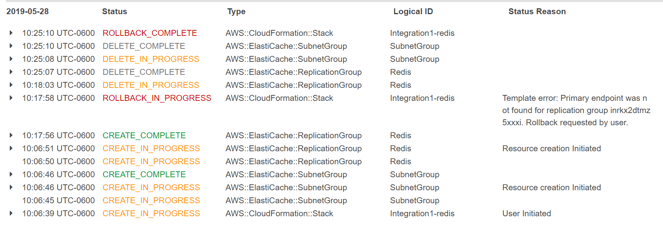
The Cost of Wrong
App Code: 1 min
IaC Code: 15 minutes

Slide 16
IaC with Unit Tests
Development
!
!
Write Spec
Unit Test
Deploy
Verify
1 min
15 min
!
1 min
5 min
!

Slide 17
What we lose with no unit testing
Time
Refactoring common functionality
Readability
Reusability
Create common libraries
https://github.com/rackspace-infrastructure-automation/

Slide 18
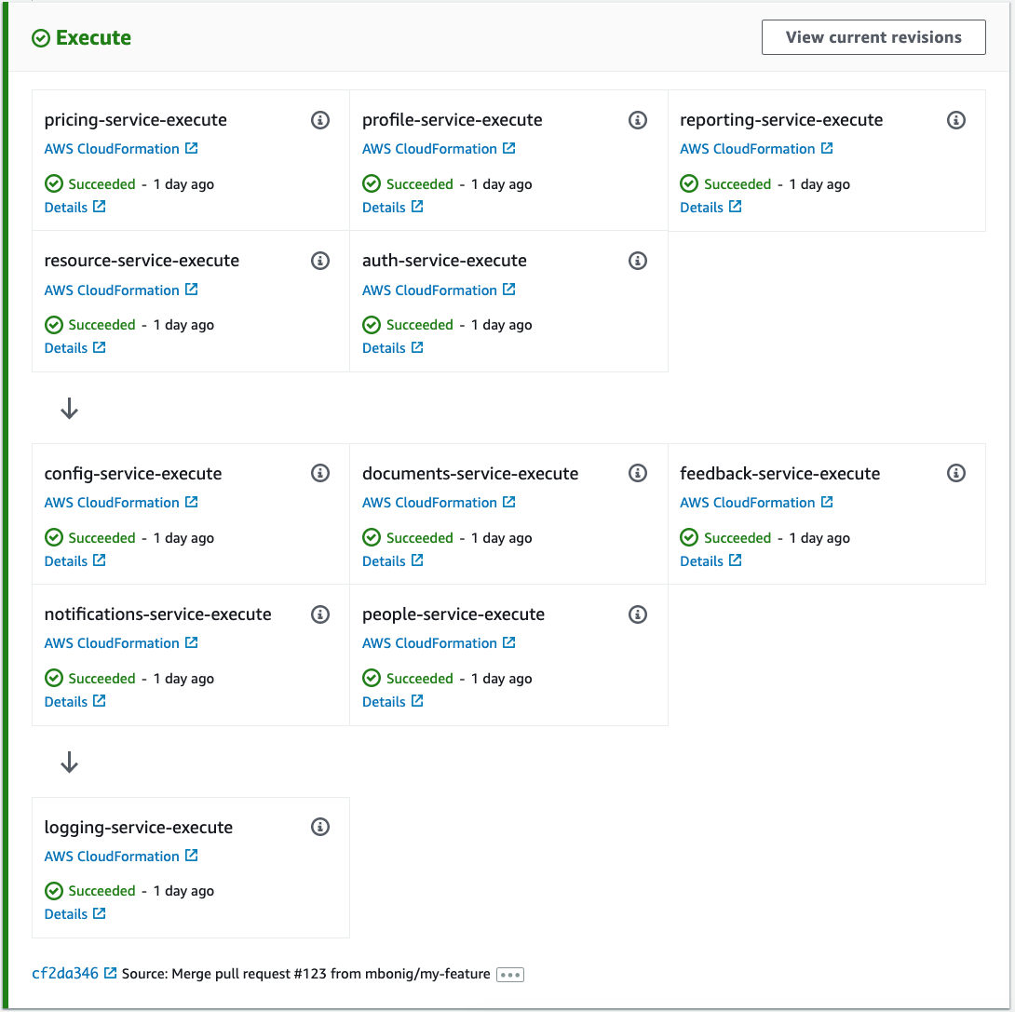
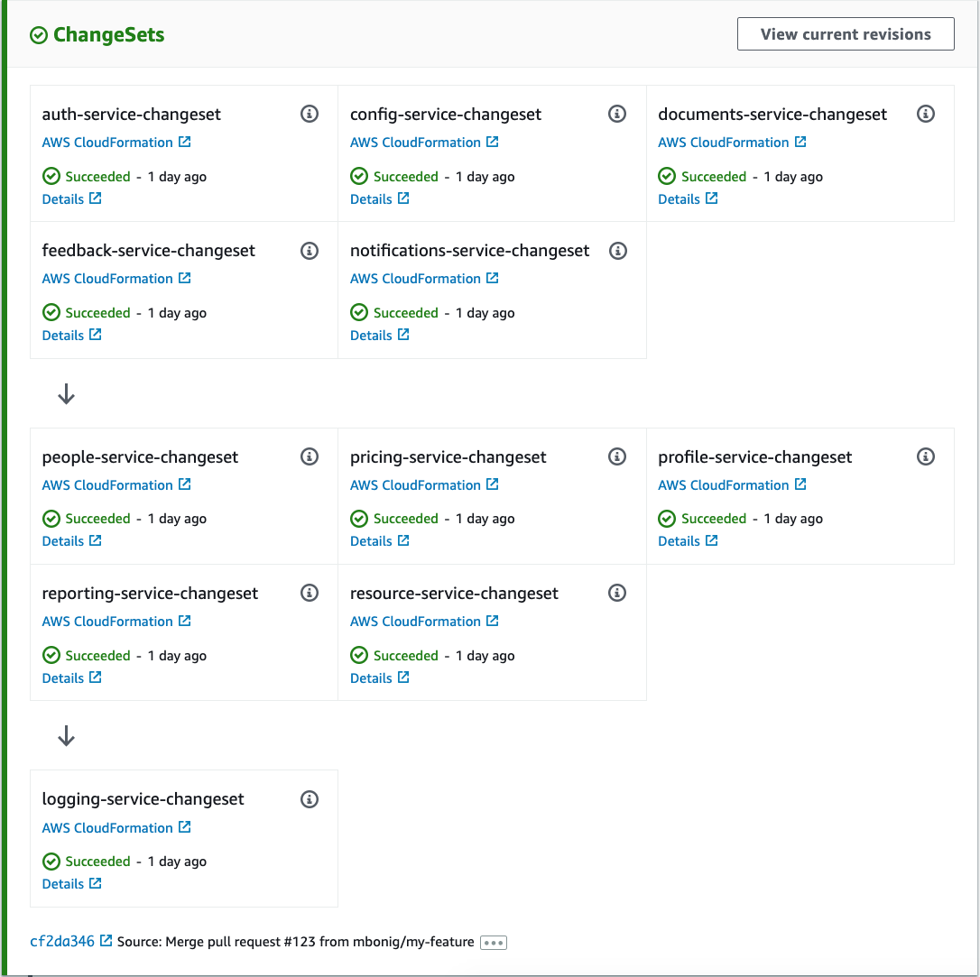
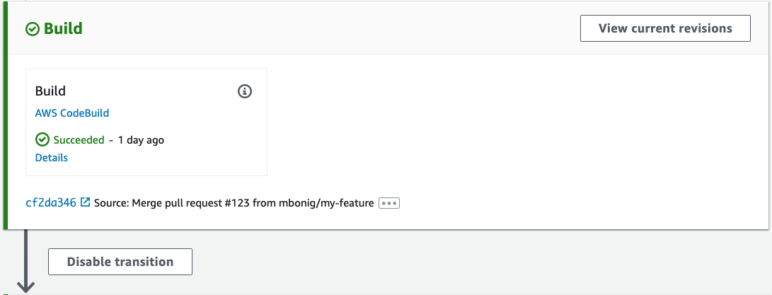
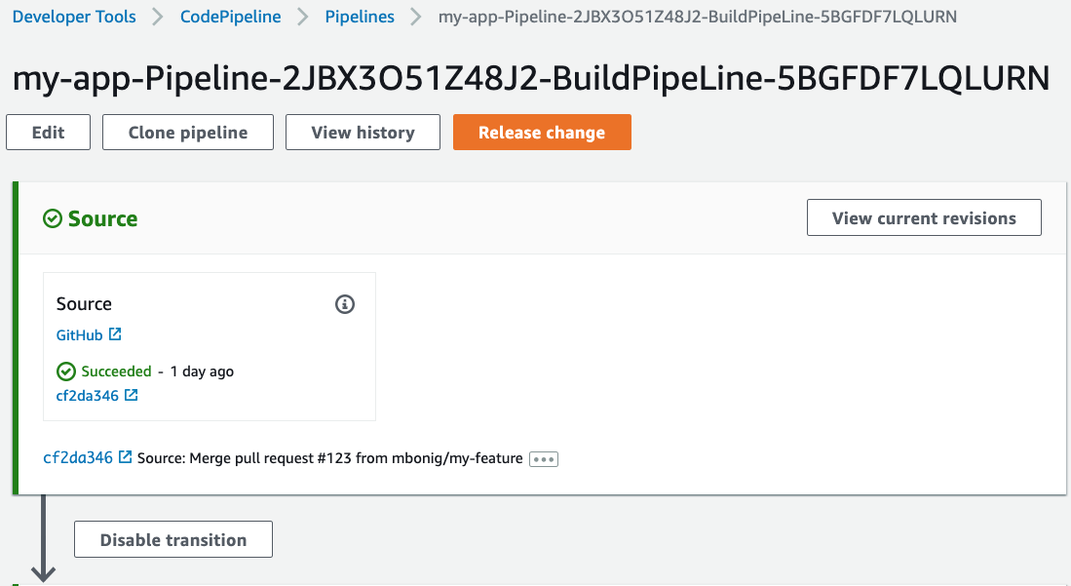
When it’s wrong
microservices vs macro CICD

Slide 19
How’d this happen?
“Easier” vs “Right”
Didn’t use generation

Slide 20
AWS & IaC Testing Options
AWS CDK
AWS CloudFormation
AWS Amplify

Slide 21



Example
AWS CodePipeline
AWS CodeBuild
Amazon Simple Storage Service (S3)
Amazon CloudFront
branch
buildSpec
Website hosting
optional

Slide 22

Show me the code!

Slide 23
Conclusion
Learn from Application Development
Faster
Reusable Code
Template generation

Slide 24
Q&A
Code at github.com/mbonig/cdk-test
Fork and submit Pull Request

